Slide 1
Steel Defect Detection
Yongchang Feng, Tue Ngo
August 3, 2020

Slide 2
Overview
An U-net model is build to classify and segment steel defects. Include in this report are:
Exploratory data analysis and Visualization
Data preparation
Build the U-net model with Keras
Training the model with augmentation (on both images and masks)
Post-processing and analysis
Discussion and summary

Slide 3
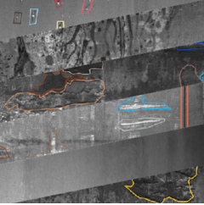
Introduction and Objectives
Images from high frequency cameras are used for defect detection in steel making.
The objective of this project is an algorithm which localize and classify surface defects on a steel sheet.
The metrics is the mean Dice coefficient which defined by: 2 * |X ∩ Y| / (|X| + |Y|)
where X is the predicted set of pixels and Y is the ground truth. The Dice coefficient is defined to be 1 when both X and Y are empty
Speed is also critical

Slide 4





Visualization and EDA
Key EDA discoveries:
On about half of the training image, there are no labeled defects. (with: 5902, without: 6666)
One image have 4 masks. Majority of masks are without defects. (with: 7095, without: 43177)
Defect classes is highly un-balanced. (897/247/5150/801)
Class2 & class3 defects have long shape and might be directional
DBSCAN in stand of K_mean in clustering
limits rotation angle in augmentation
Defects cluster together

Slide 5
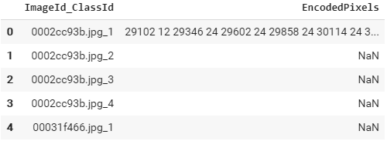
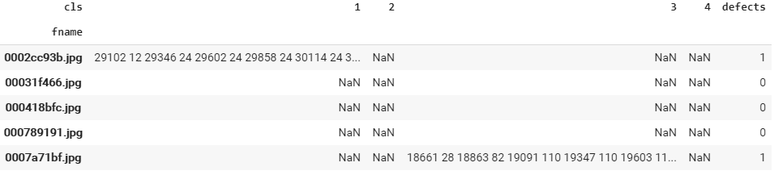
Data Preparation
Original data file lists each class of defect of a image in separate rows. Merge them into different columns of same row.
Build a utility, which convert run-length encoded pixels into masks
These masks will be used as targets (labels) in training
Targets connects to the training image (training input variables) by file name (id).

Slide 6
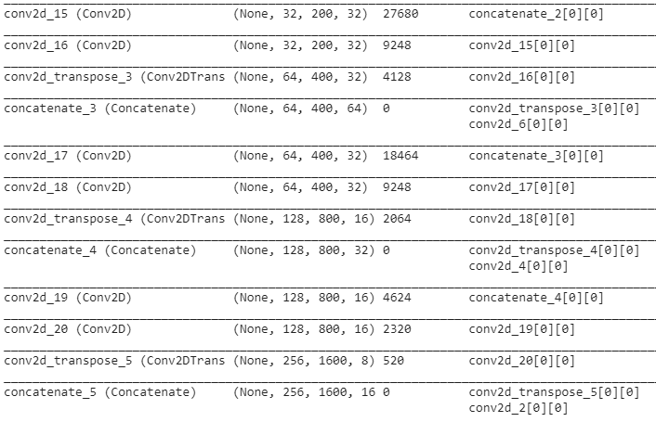
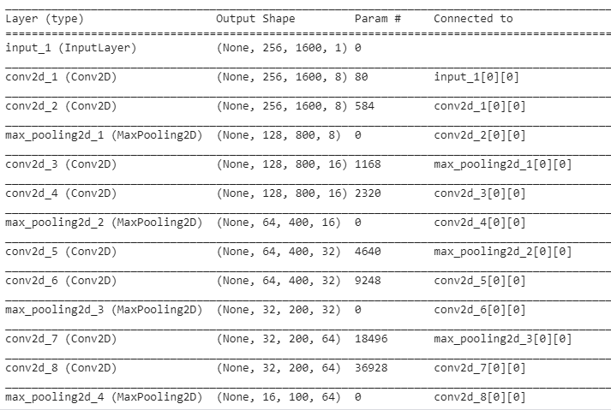

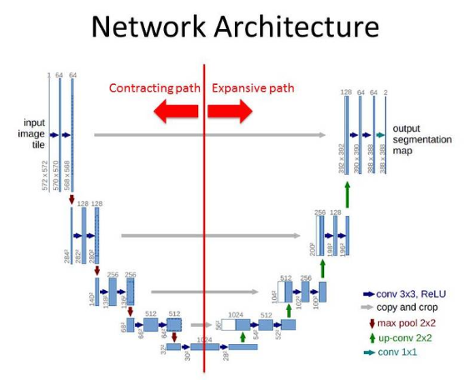
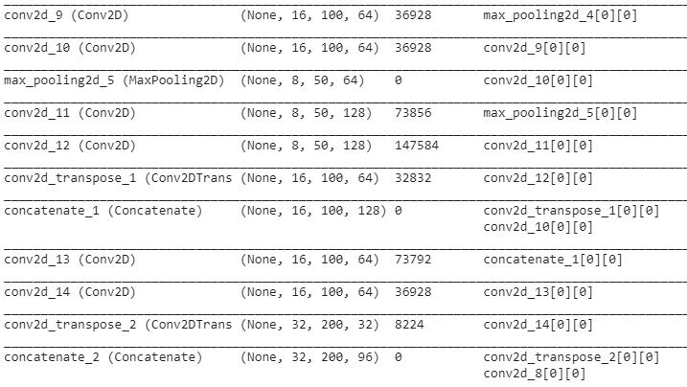
A Baseline Model – U-net
8
Illustration of a similar U-net
Source: https://www.kaggle.com/jesperdramsch/intro-chest-xray-dicom-viz-u-nets-full-data#Vanilla-Unet
16
32
32
64
128
64
128

Slide 7
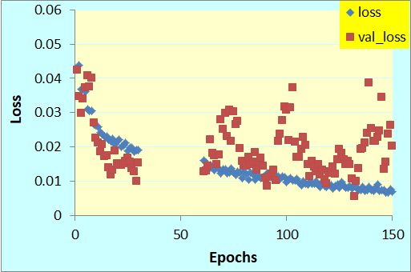
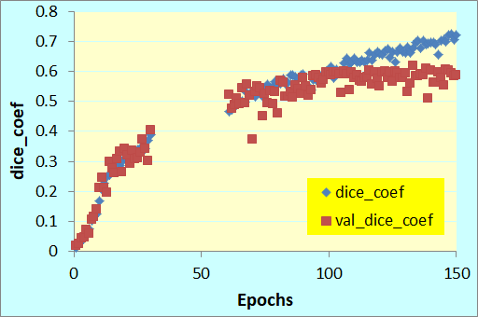


Results on the Baseline Model
Although training loss continue decreases and training dice_coef continue improve at 150 epochs, the validation results doesn’t improve after 100 epochs.
Dice coefficient of 0.6 has been achieved.

Slide 8
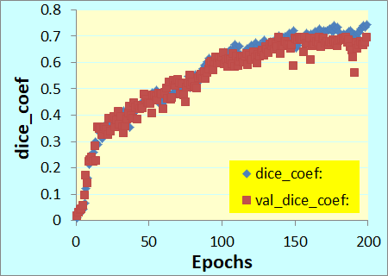
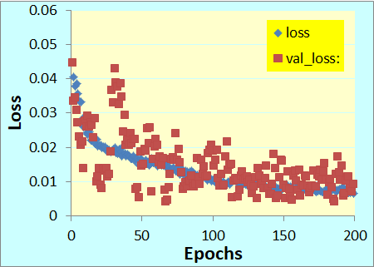
Results on Augmentation
No Augmentation
with Augmentation
Augmentation used: width_shift 0.5, height_shift 0.5, horizontal and vertical flip, rotation_range 5, brightness_range [0.8, 1.2], zoom_range 0.2, fill_mode=‘wrap'
Dice coefficient improved to 0.7
Also, increase batch size from 16 to 32

Slide 9
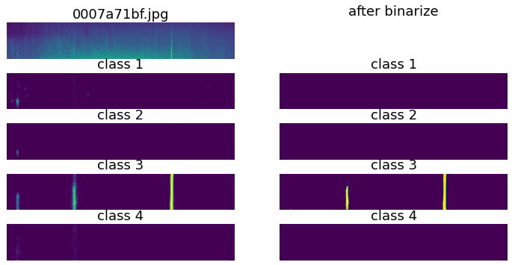

Visualize the Results – One Example
Here shown one example which have correct detected areas and false positive as well as false negative areas.
Correct
label
False Negative
False Positive

Slide 10
Post Processing and Analysis
Various post processing techniques are used. Optimized results summarized in following table:
Dice1, 2, 3 are measured per image and averaged over all validation images.
Dice1 is on all images, Dice2 on the images which have defects, and Dice3 on images without defects
(1- Dice3) is an indicator for false positive. There is a “trade-off” between Dice2 and Dice3.
Post process is to optimize the trade-off
Successfully reduce the false positive rate for around 20% to 6%, with about 1% reduction in Diec2.
The techniques used include: apply threshold on likelihood, use erosion/dilation to filter out noise, and further filter out small and few defects.
Dice4 is measured per mask (4 masks for each image). This competition is based on Dice4.

Slide 11
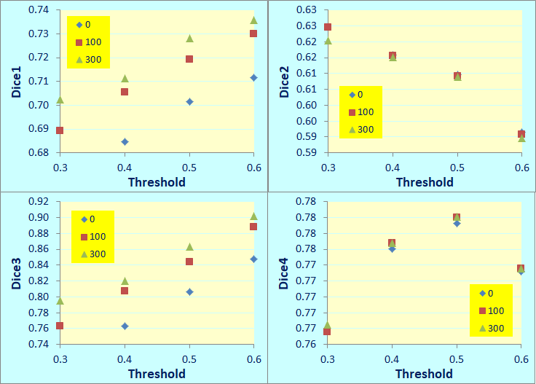
Post Processing Optimization
Min Defect Size
Higher threshold improves Dice3, as it reduces false positive
Larger min_size of defects also improve Dice3
Dice2 trades off with Dice3
Optimize threshold and min_size based on Dice4, which is the metrics for this competition.
Threshold = 0.5
Min_size between 100 and 300.
Min Defect Size
False Positive

Slide 12
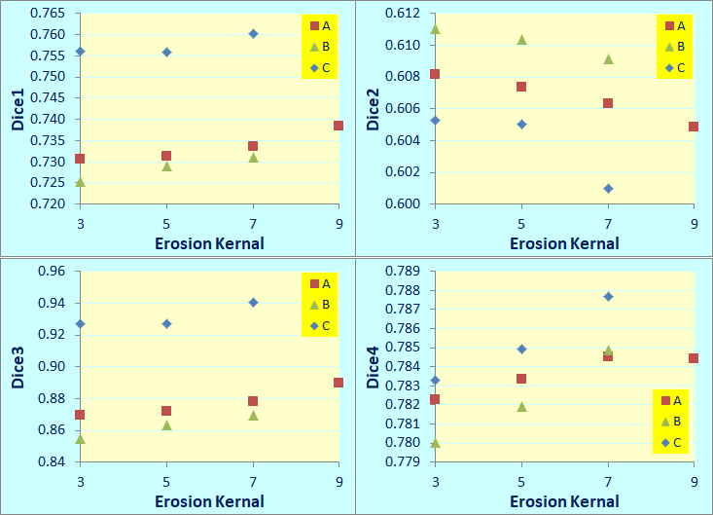
Post Processing Optimization
Filter out images with few defects significantly improves Dice3.
Larger erosion kernal also improves dice3
Set dilation kernal larger than the erosion kernal improves Dice2, as it makes the defects “fatter”.
Based on Dice4, optimized parameter as following:
Erosion kernal: (7, 7)
Dilation kernal: (9, 9)
Filter = [800, 800, 1200, 3000]
A) dilation kernal = erosion kernal ; B) and C) dilation kernal = erosion kernal + 2
A) and B) no total size filter; C) with total size filter [800, 800, 1200, 3000]

Slide 13
Other Possible Solutions
Here are some other possible approaches which are not explore in this work:
Other models, such as:
Mask CNN
Pipeline / Stocking – at 1st step make a classification on defect vs. no defect (CNN), then on the 2nd step, only on the images with defects, use U-net for defect classification and segmentation.
Model ensemble
Because fast speed is also a critical objective, a simple one stage model was used in this project.
Use pesudo labeling technique to increase sample size
Use stratified shuffle split to mitigate impact of un-balanced sample
This need to be done by mask, would need to change data preparation, an idea for future work
Two new ideas for post processing:
Use sum of likelihood of all defect classes to defect vs. no defect, then use the max likelihood to classify the defect. Two stage decision making process but use the same network. Expect “false negative” will be reduces.
Use the max likelihood of a cluster to represent the whole cluster. Expect this to increase the detected defects.
These ideas are illustrated in next two pages in more details, could be part of future work.

Slide 14
Use sum of likelihood of all defect classes
Multiple masks suggest there is a defect there, if a added the likelihood together, could know that there is a defect there even though each likelihood is lower than threshold.
Correct
label
False Negative
False Positive
Only class3 indicates a defect.

Slide 15
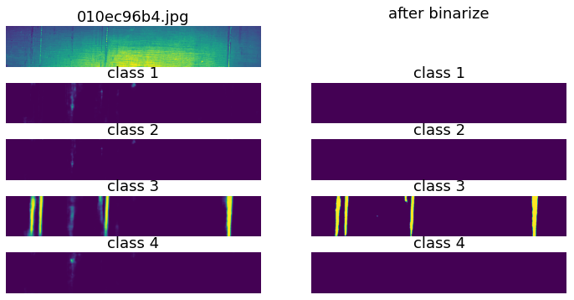
Use the max likelihood of a cluster to represent the whole cluster
Potentially, a defect if we sum up the likelihoods
Use the max likelihood of a cluster to represent the whole cluster, this defect could be extended.

Slide 16
Summary
An U-net model is build for classification and segmentation of steel defects
Exploratory data analysis shows that training data is highly un-balanced among defect classes and there is no defects on many sample images
The model is trained with augmentation (on both images and masks)
A few computer vision techniques are used in post-processing to further improve the detection
Dice coefficient of 0.79 is achieved
A few ideas are proposed for future work

Slide 17
References
https://towardsdatascience.com/understanding-semantic-segmentation-with-unet-6be4f42d4b47
https://tuatini.me/practical-image-segmentation-with-unet/
https://www.kaggle.com/c/severstal-steel-defect-detection
https://www.kaggle.com/c/severstal-steel-defect-detection/discussion/114394
https://machinelearningmastery.com/how-to-configure-image-data-augmentation-when-training-deep-learning-neural-networks/ (How to Configure Image Data Augmentation in Keras)
https://github.com/soroushj/keras-balanced-batch-generator (Balanced Batch Generator)
https://iopscience.iop.org/article/10.1088/1742-6596/1213/2/022003/pdf (Exploring An Easy Way for Imbalanced Data Sets in Semantic Image Segmentation)
https://stats.stackexchange.com/questions/5366/clustering-k-means-or-otherwise-with-a-minimum-cluster-size-constraint

